Slide 1
Reducing gender inequality and the role of young people in it
Evelyn Neudorf, Neudorf@tlu.ee
School of Educational Sciences, Tallinn university

Slide 2
Gender equality is the equal rights, duties, opportunities and responsibilities of women and men in working life, education and participation in other areas of social life.
A gender role is a set of certain norms that, depending on cultural traditions, are assigned to an individual or a group of people according to whether they are male or female.
In many countries, society places different expectations on fathers and mothers. The father's primary responsibility is to provide for the family financially, and the mother is expected to be more emotionally involved

Slide 3
According to traditional gender roles, it seems that women should prefer domestic duties to paid work, and men should devote more time and energy to career rather than family life. For the lastsixty years, the level of employment of women in Estonia and other European countries has been high.
Time use studies show that women do far more housework every day. Estonian women, the majority of whom are employed, have a double burden by doing unpaid housework, which in turn reduces their opportunity to realize themselves in society, do voluntary work, run for representative bodies, etc. At the same time, women are paid less than men for their paid work.
Notes:
Traditionally, a woman is seen in the role of wife or mother, while a man's primary area of responsibility is economic. The more traditional the society, the more unequal the opportunities for women and men. The traditional role of a woman is a housewife who takes care of children and husband. For example, a woman is not seen as a successful member of society as a man is seen. At the same time, the man's family role is not particularly valued. A man is defined by his professional career, while a woman is primarily defined by her family role.
According to studies conducted in Estonia, both women and men think that strength, dominance, courage, self-confidence, greed, success, logic, decisiveness and aggressiveness are the most masculine traits. Feminine personality traits are shyness, helplessness, tenderness, naivety, compassion, sensitivity, talkativeness, nurturing and dependence

Slide 4
Why is it important to break down gender roles?
By removing gender-stereotypes from the children's learning and playing environment, all children are able to develop to their fullest potential. They no longer absorb potentially harmful stereotypes that could become the basis for gender-based violence later in life.
it promotes equality and freedom of choice. By doing so, individuals are able to pursue their passions, interests, and career paths without being limited by societal expectations based on their gender. This leads to a more diverse and inclusive society where everyone has equal opportunities and is valued for who they are, rather than being restricted by traditional gender roles. Additionally, breaking down gender roles helps to challenge and dispel harmful gender stereotypes, leading to a more accepting and equitable world.

Slide 5
How do gender roles affect youth? (1)
Gender roles can have a profound impact on youth, shaping their beliefs, behaviors, and opportunities. Some ways gender roles affect youth include:
Limiting aspirations: Youth may feel pressured to conform to certain gender-specific aspirations and careers, limiting their choices and potential.
Stereotyping: Youth may internalize harmful gender stereotypes, leading to feelings of inadequacy and limiting their ability to express themselves fully.
Body image: Youth may feel pressure to conform to gender-specific beauty standards, leading to body image issues and potentially harmful behaviors like eating disorders.

Slide 6
(2)
Mental health: Conforming to gender roles can be emotionally and mentally taxing, leading to higher rates of depression, anxiety, and other mental health issues.
Relationships: Youth may struggle with traditional gender-based power dynamics in their relationships, leading to unhealthy and unequal relationships.
Breaking down gender roles can help youth feel freer to be their authentic selves, pursue their passions and interests, and form healthy and equitable relationships.

Slide 7
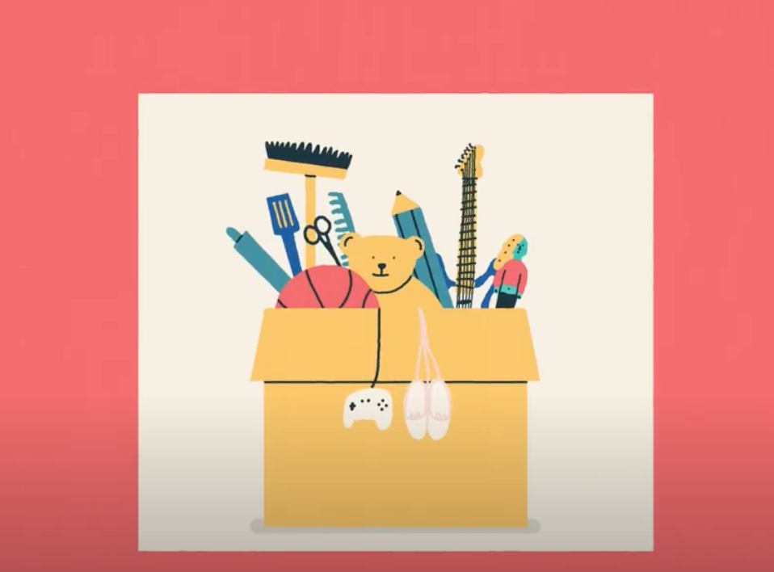

Slide 8
Discussion point:
How strongly were gender roles ingrained in your family when you were a child?
How are you going to maintain or break gender roles in your future family?

Slide 9
Gender stereotypes
A gender stereotype is a generalised view or preconception about attributes, or characteristics that are or ought to be possessed by women and men or the roles that are or should be performed by men and women. Gender stereotypes can be both positive and negative for example, “women are nurturing” or “women are weak”.
Examples of Gender Stereotypes
Girls should play with dolls and boys should play with trucks.
Boys should be directed to like blue and green; girls toward red and pink.
Boys should not wear dresses or other clothes typically associated with "girl's clothes"

Slide 10
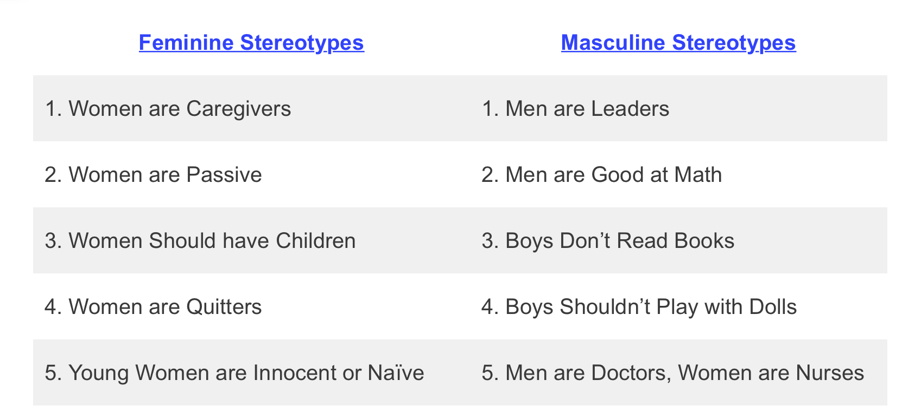
Feminine And Masculine Stereotypes
Society tends to have gender stereotypes based on the dominant forms of masculinity and femininity within a culture.

Slide 11
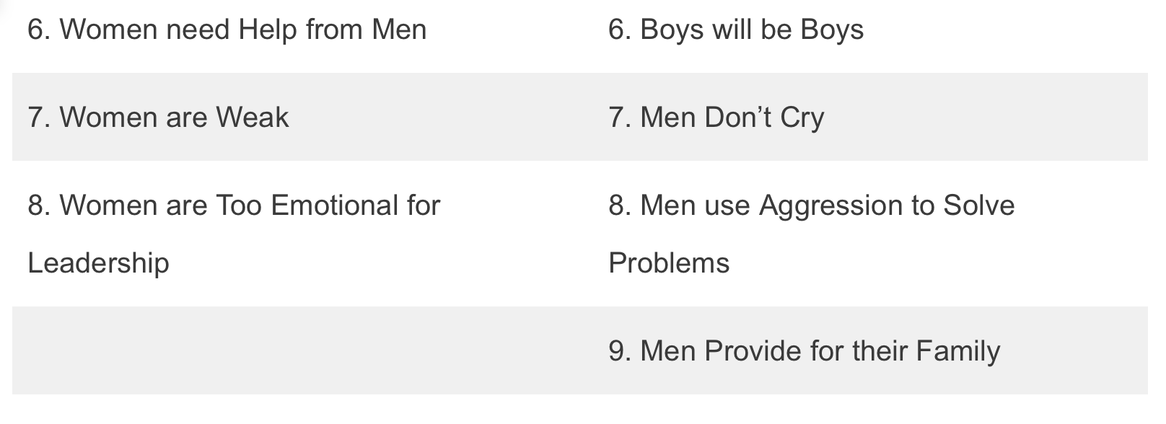

Slide 12
Notes:
https://www.youtube.com/watch?v=9je8_HEw_8Y

Slide 13
Notes:
https://www.youtube.com/watch?v=entFw5sPE1s

Slide 14
Notes:
https://www.youtube.com/watch?v=entFw5sPE1s

Slide 15
Discussion: Have you also experienced this attitude towards yourself or your friend?
what can you do to reduce this attitude?

Slide 16
Career choice and men as teachers in ECE
Men in Early Childhood Education: Male Teachers’ and Parents’ views (2015).
They are satisfied with fixed salary and monitoring the progress of the children, but not satisfied with the size ot the salary, bulky paperwork, fast paces of the kindergarten and society's negative preconceptions about male teachers.
The parents think it is important to have male teachers in kindergartens, and their personal experience with the teachers is positive. The parents agree that the society partly has a negative attitude towards male teachers and commonly share a stereotypical view that a man has to tace care of his family’s economic sustenance.

Slide 17
Study on gender behaviour and its impact on education outcomes
boys are more likely than girls to be early leavers from education and training (ELET).
Boys are also more likely than girls to repeat a year of education.
PISA 2018 data shows that boys perform marginally better than girls in maths across the EU.
While there is a mixed picture in terms of boys’ and girls’ performance, girls generally outperformed boys in PISA 2018 for science.
Source: https://op.europa.eu/en/publication-detail/-/publication/414f506c-df95-11eb-895a-01aa75ed71a1
Notes:
https://op.europa.eu/en/publication-detail/-/publication/414f506c-df95-11eb-895a-01aa75ed71a1

Slide 18
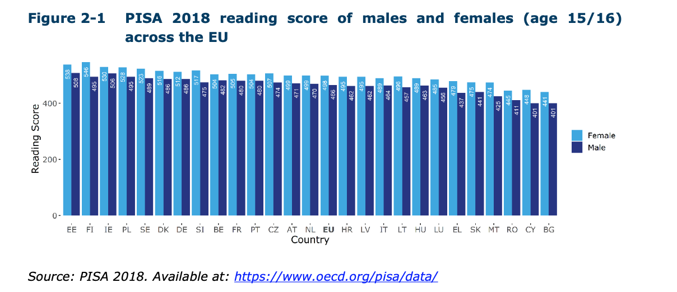
Boys are behind girls in reading by over six months in every Member State

Slide 19
Conclusion: 10 outlines on why and how young people can reduce gender inequality
Education: Young people can educate themselves and others on the issue of gender inequality and its impact on society.
Speak out: They can use their voices to speak out against gender-based discrimination and promote equality.
Challenge gender stereotypes: They can challenge gender stereotypes in their own lives and in the media.
Support women’s empowerment: They can support women's empowerment by volunteering their time, resources, or skills to organizations that work towards women's rights and equality.
Advocate for change: They can advocate for policy and legislative changes that promote gender equality, such as equal pay for equal work and ending gender-based violence.

Slide 20
Lead by example: They can lead by example by modeling equitable behaviors and attitudes in their relationships, communities, and the workplace.
Encourage gender-inclusive policies: They can advocate for gender-inclusive policies in schools, universities, and in the workplace.
Promote diversity and inclusiveness: They can work towards creating a more inclusive and diverse society that values and respects all individuals, regardless of gender.
Support gender-diverse individuals: They can support and uplift gender-diverse individuals and communities who face additional barriers to equality.
Collaborate with others: They can collaborate with individuals and organizations from diverse backgrounds to amplify their efforts and create a collective impact in reducing gender inequality.

Slide 21
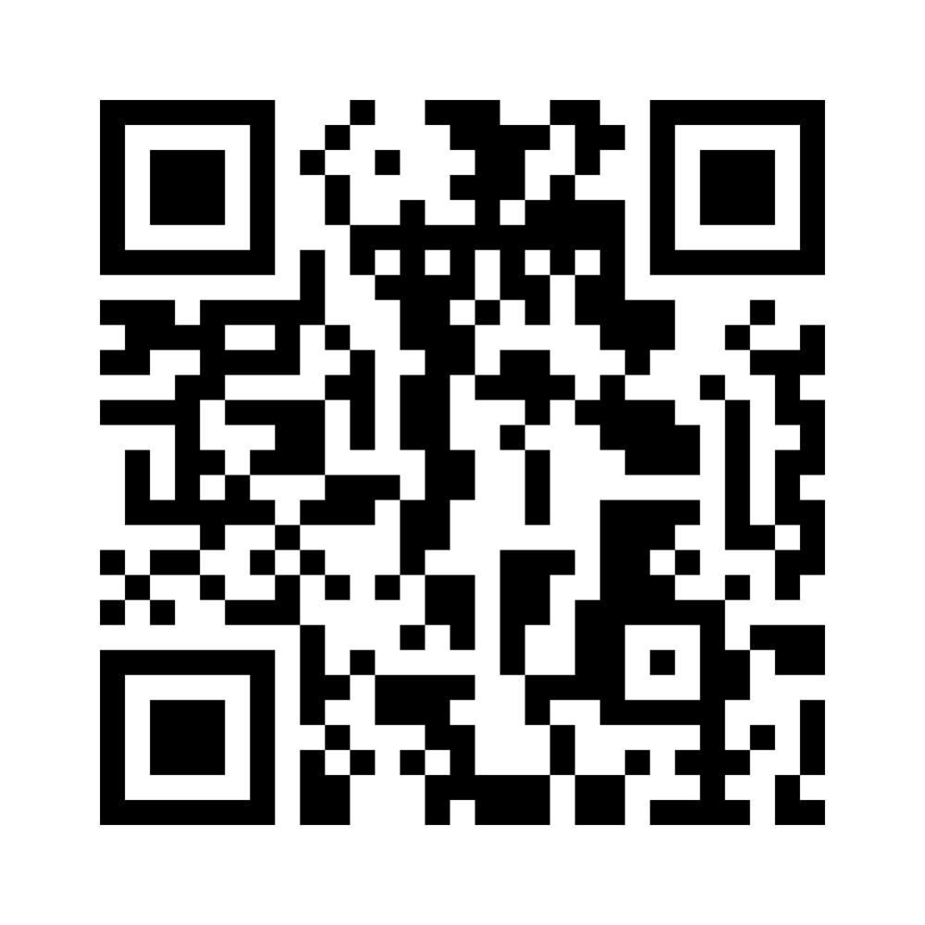
How aware are you of gender equality?
CODE IS 5580 9560
Notes:
https://www.menti.com/alonjmxm2f3t

Slide 22
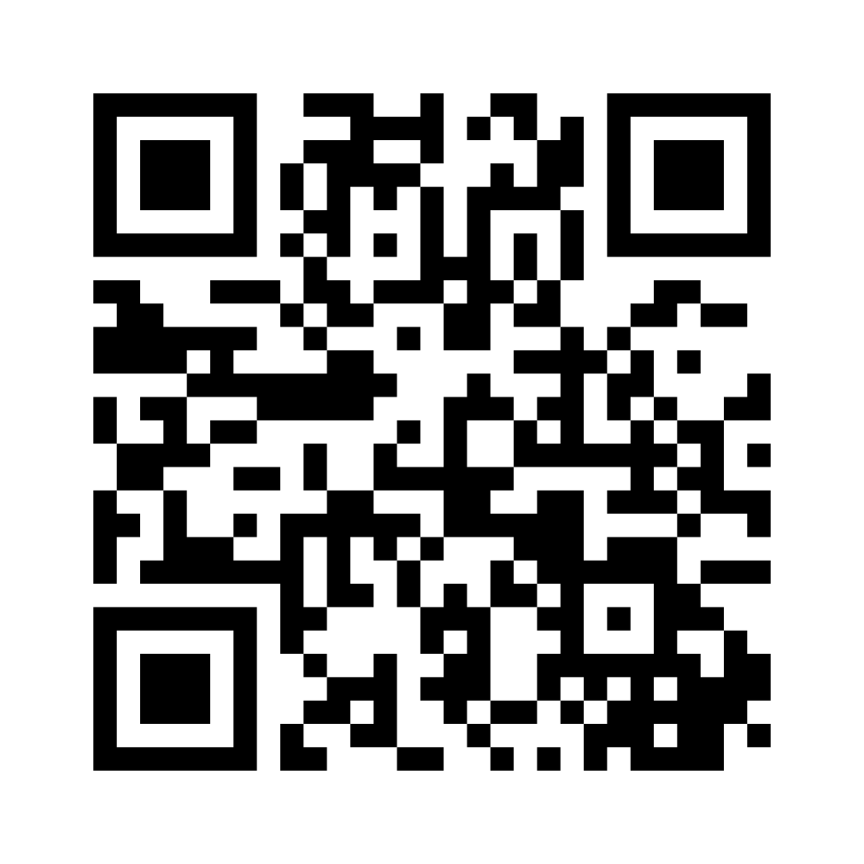
How aware are your regular friends about gender equality?
Code is 8405 2960
Notes:
https://www.menti.com/aldxpmshehvi

Slide 23
For further reading
https://www.globalyoungvoices.com/fast-news-blog/2018/4/3/how-youth-can-take-action-to-ensure-gender-equality
https://www.unwomen.org/en/digital-library/publications/2017/5/youth-leap-into-gender-equality
https://op.europa.eu/en/publication-detail/-/publication/414f506c-df95-11eb-895a-01aa75ed71a1

Slide 24
Thank you!
Evelyn Neudorf
neudorf@tlu.ee

