Slide 1
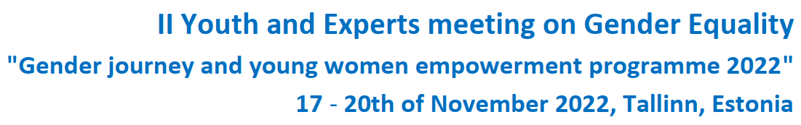
Gender and education
19 November 2022

Slide 2
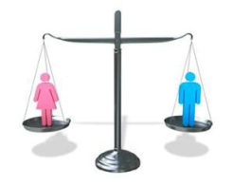
Key words
gender equality, pay gap, equal treatment, family models, gender roles

Slide 3
Talking points
Gender equality in Estonia
Education in Estonia
Gender equality in educational policy documents
Breaking gender stereotypes and promoting gender-sensitive
education
Good examples and practices for teachers, young people and
the community to promote gender equality

Slide 4
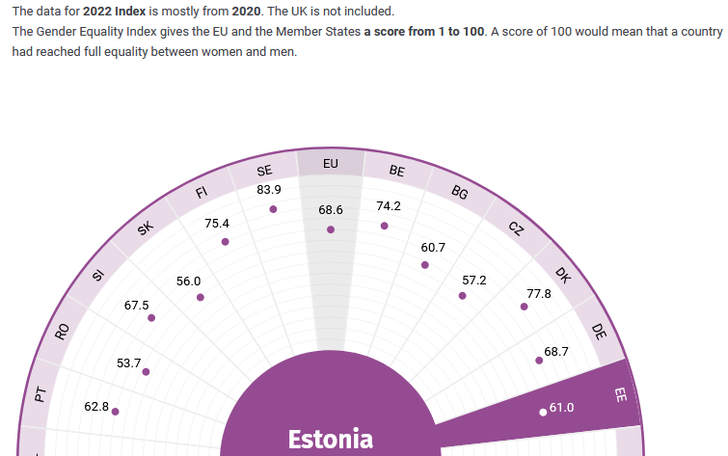
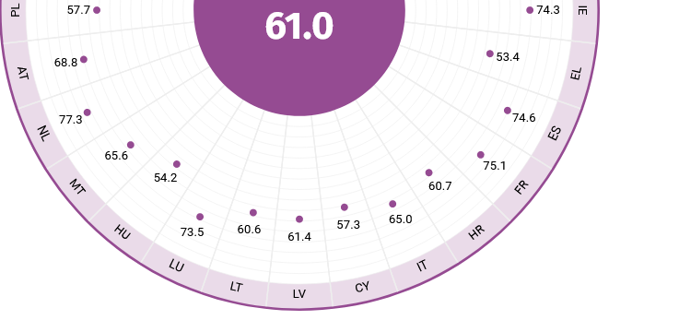
Gender equality index - Estonia
Bulgaria 60.7
Czech Republic 57.2
Croatia 60.7
Lithuania 61.4
Latvia 60.6
Hungary 54.2
Poland 57.7
Romania 53.7
Slovenia 67.5
https://eige.europa.eu/gender-equality-index/2022/EE

Slide 5
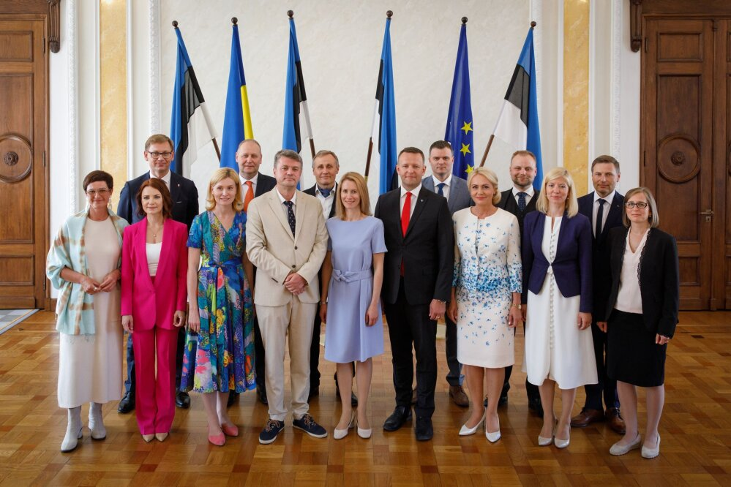
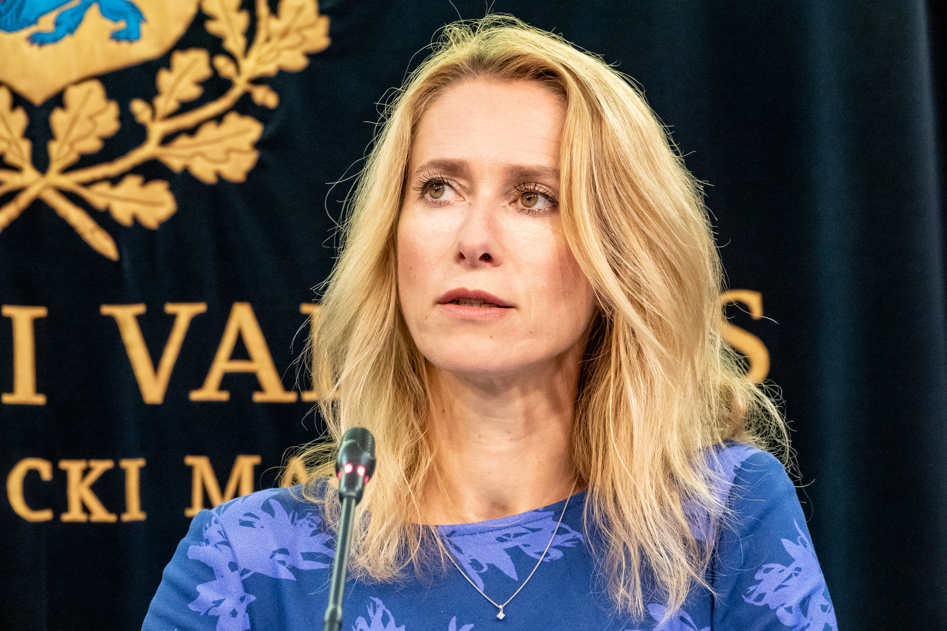
Gender equality in Estonia
Gender-balanced government
Female prime minister
https://www.aripaev.ee/uudised/2022/07/18/kallase-teine-valitsus-andis-ametivande
https://pealinn.ee/2022/07/22/kaja-kallas-eesti-hea-kaitsehoiak-peab-votma-kremlilt-runnakumotted/

Slide 6
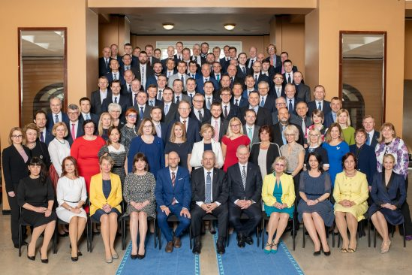
Estonian Parliament – Riigikogu
28 women, 73 men
https://www.riigikogu.ee/riigikogu/koosseis/

Slide 7
Gender equality in Estonia
Gender issues began to receive attention in Estonia in the late 1990s, following the ratification of international conventions and preparation for accession to the European Union (EU).
The legal framework for gender equality is enshrined in the Estonian Constitution, which states that everyone is equal before the law and no one shall be discriminated against on the grounds of sex.
The Gender Equality Act that followed Estonia’s accession to the EU in 2004, which defines equality of women and men as a fundamental human right and provides for gender equality to be mainstreamed into all areas of social life.
There is no system for regular reporting on gender equality initiatives and progress to the government and/or to representative elective bodies within the Estonian policy-making system.
A national gender equality plan and subsequent systemic approach are not yet in place in Estonia. Rather, the state has provided actions and plans that intend to regulate specific gender equality policies, for instance on the gender pay gap.
https://eige.europa.eu/gender-mainstreaming/countries/estonia

Slide 8
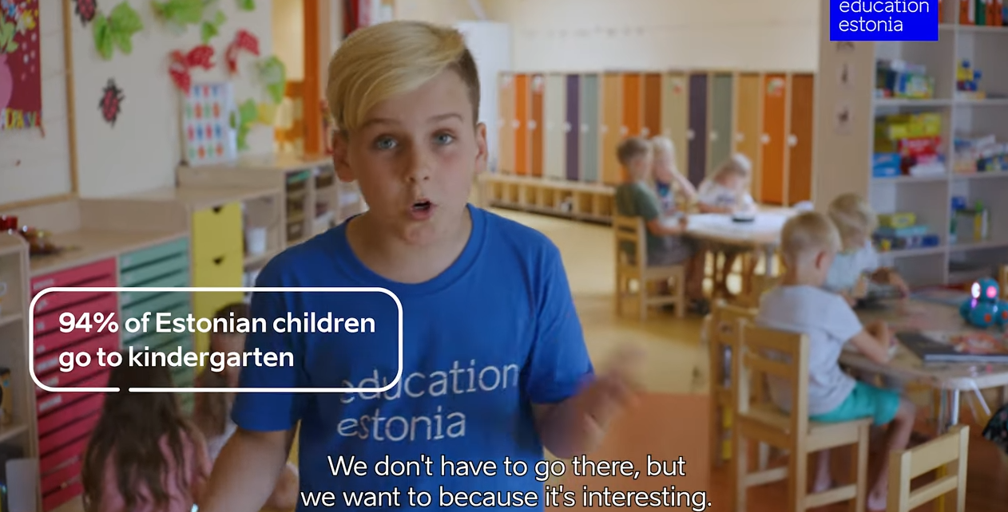
Education in Estonia
https://www.youtube.com/watch?v=wvyya41o_XA

Slide 9
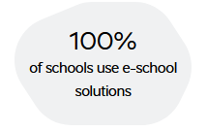
1. An important role of technology in education
digital learning materials
e-diaries
e-tests
e-database
https://e-estonia.com/solutions/education_and_research/school_management_systems/

Slide 10

eKool (e-school) since 2002
A school management tool with functionalities for
pupils
parents
teachers
schools
government
partners
https://e-estonia.com/solutions/education_and_research/school_management_systems/

Slide 11
2. A high degree of autonomy granted to schools and teachers
the national curriculum leaves space for the schools to develop its
own curriculum
all schools can decide on their goals and the focus of studies
principals can decide on how to allocate the budget and evaluate the
needs for teacher training
teachers decide on the textbooks and teaching methods as long as
learning outcomes stipulated in the national curricula are reached
https://estonianworld.com/knowledge/autonomy-offers-estonian-teachers-greater-workplace-satisfaction

Slide 12
3. Focus on personalised learning paths
Estonia’s Education Strategy 2021-2035
personalisation and diversification of learning
supporting learning through digital solutions
The strategy says nothing about gender equality goals in education.
https://www.educationestonia.org/estonia-introduced-developments-in-ai-in-education/

Slide 13
Gender equality in educational policy documents
2004 Gender Equality Act
§ 10. Promotion of gender equality in education and training
“Educational and research institutions and other organisations delivering training shall ensure equal treatment of men and women in vocational guidance, education, professional and vocational development and re-training. The curricula, study materials used and research conducted shall facilitate the abolishment of unequal treatment of women and men and promote equality.”

Slide 14
National curriculum for kindergartens
New curriculum currently being developed, mentions gender equality as one of core values.
Focus on developing digital skills.

Slide 15
National curricula for basic and upper secondary schools
Mention gender equality as a core value alongside other social values such as liberty, democracy, cultural diversity,
tolerance, environmental sustainability, solidarity, etc.
So far, Estonia lacks any national education policy document that would explicitly say what gender equality objectives in education are.

Slide 16

Write down the 3 greatest achievements in your life that you are really proud of.

Slide 17
Write down the qualities / characteristics that have helped you achieve these three things?

Slide 18
Are the qualities proposed traditionally considered feminine, such as beautiful, gentle, caring, compassionate or
masculine, such as decisive, determined, goal-oriented, persistent?

Slide 19


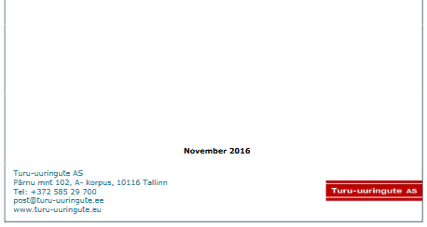


Slide 20
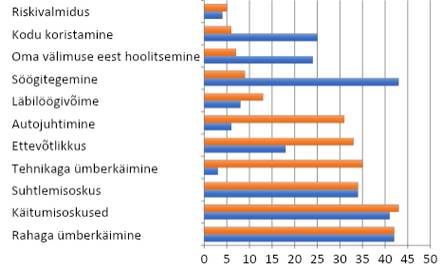

A long way to go to achieve gender equality.
What skills and qualities should boys and girls be taught?
Gender equality monitoring (2016)
Willingness to take risks
Cleaning the home
Cleaning the home
Taking care of one’s appearance
Cooking
Girls
Boys
Competitiveness
Driving
Entrepreneurial spirit
Use of technology
Interpersonal skills
Behavioural skills
Financial skills
https://enut.ee/files/soolise_vordoiguslikkuse_monitooringu_raport_2016.pdf

Slide 21
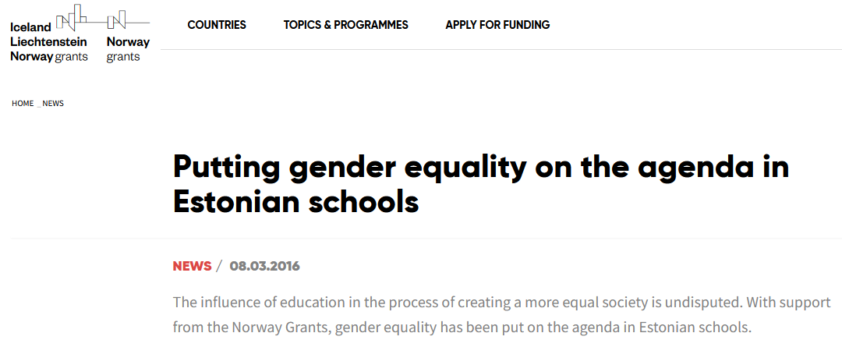
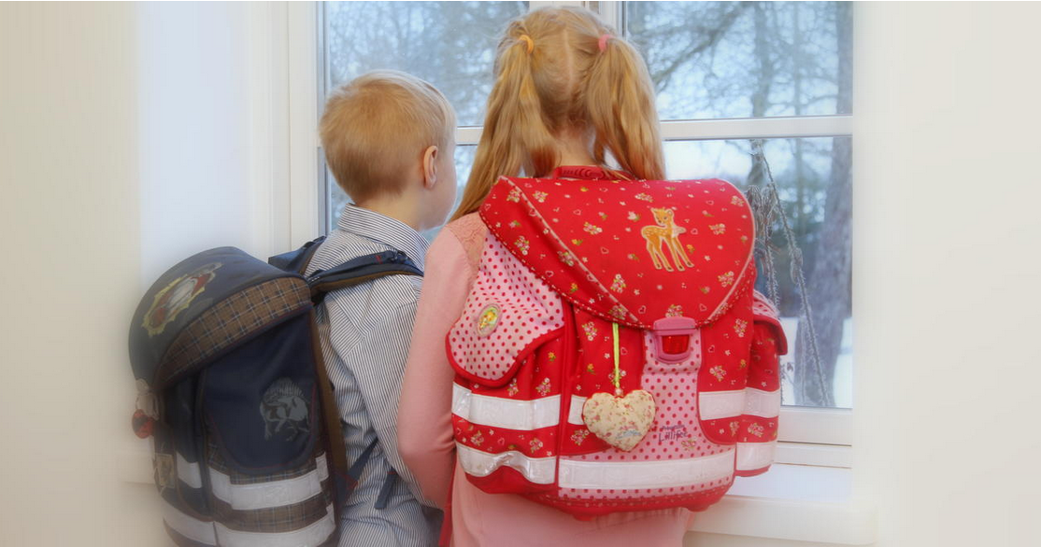
What about promoting gender equality in Estonian schools?
Project: Integrating gender into teacher education and training (Norway Grants project, 2014-2015)
https://eeagrants.org/news/putting-gender-equality-on-the-agenda-in-estonian-schools

Slide 22
Factors contributing to promoting gender-sensitive education and combating gender stereotypes in Estonia
an active role played by NGOs: awareness-raising, projects,
delivery of in-service teacher training, preparation of teacher
resources, etc
start in the early 2000s mostly thanks to Nordic cooperation
access to Nordic and EU funding and expertise
cooperation with teacher training institutions: Tallinn University,
University of Tartu
cooperation with the Ministry of Education and Research

Slide 23
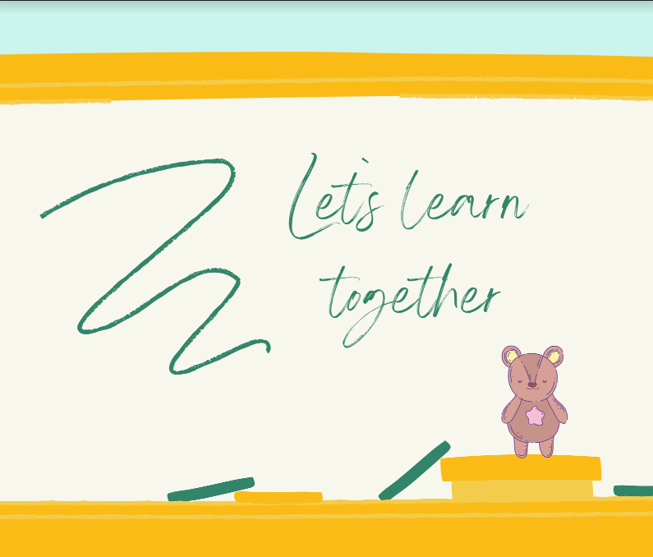



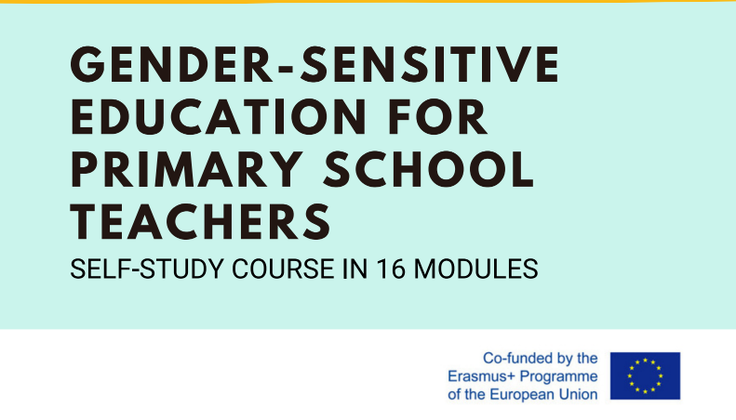

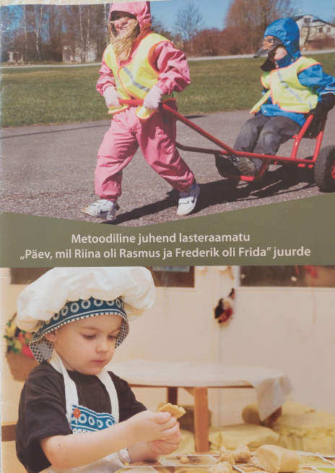
Breaking gender stereotypes and promoting gender-sensitive education - project-based work (since 2008)
https://www.gendernora.cz/l/fair-play-at-schools2/
https://www.enu.ee/lisa/374_Vabaks.pdf
https://bre-ak.eu/public/Materialid/BREAK-OPETAJAD-36lk_A4_3bld-ENG.pdf
https://enut.ee/files/metoodiline_juhend.pdf
https://enut.ee/sugu-ja-haridus-keeles-ja-meeles-artiklikogumik/

Slide 24
Integrating gender into teacher education and training (Norway Grants project, 2014-2015. Research findings
Survey of nearly 1,000 students, pre-school, primary school and vocational school teachers about their experiences with and attitudes towards gender roles in school. Results:
fair treatment in school, regardless of gender, is important for both girls and boys
both genders agree that boys overall reap more benefits at school than girls
students perceive that teachers have different expectations for boys and girls
boys are met with lower requirements to perform well in school
boys’ violent behaviour is often tolerated
girls strive to perform better even if their grades are good
the expectations of masculinity that boys are met with at school are strong
the majority of the students believe teachers’ gender has little relevance in teaching, the most important thing is teachers’ dedication to their subject
https://eeagrants.org/news/putting-gender-equality-on-the-agenda-in-estonian-schools

Slide 25
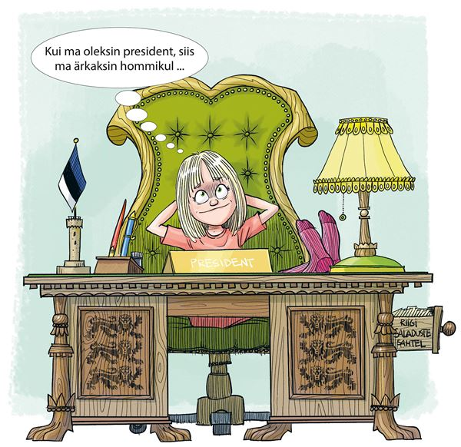
Current trends: fewer gender stereotypes in textbooks and new gender roles promoted from early years
If I were president, I would wake up in the morning ...
Illustration from The Estonian Language textbook, Grade 1
Eesti keele õpik I klassile. Avita Pille Arnik.
https://www.opiq.ee/Kit/Details/141

Slide 26
Current trend: Increased attention to gender equality
With the launch of Horizon Europe – the key funding programme for research and innovation (R & I) – in 2021, a new eligibility criterion was introduced to strengthen gender equality as a cross-cutting priority:
organisations applying for Horizon Europe funds are required to have a gender equality plan (GEP) in place. For the calls with submission deadlines in 2022 and beyond, the GEP eligibility criterion will apply to all parts of Horizon Europe.
https://eige.europa.eu/gender-mainstreaming/toolkits/gear/horizon-europe-gep-criterion

Slide 27
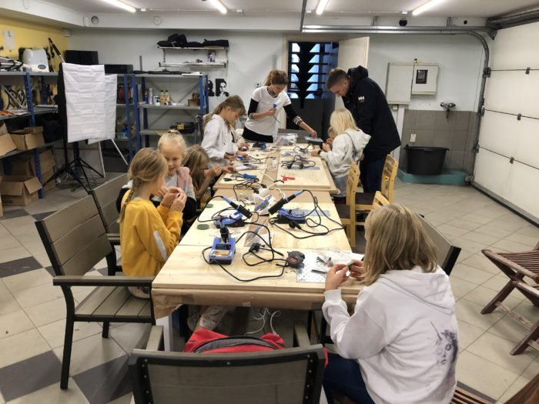
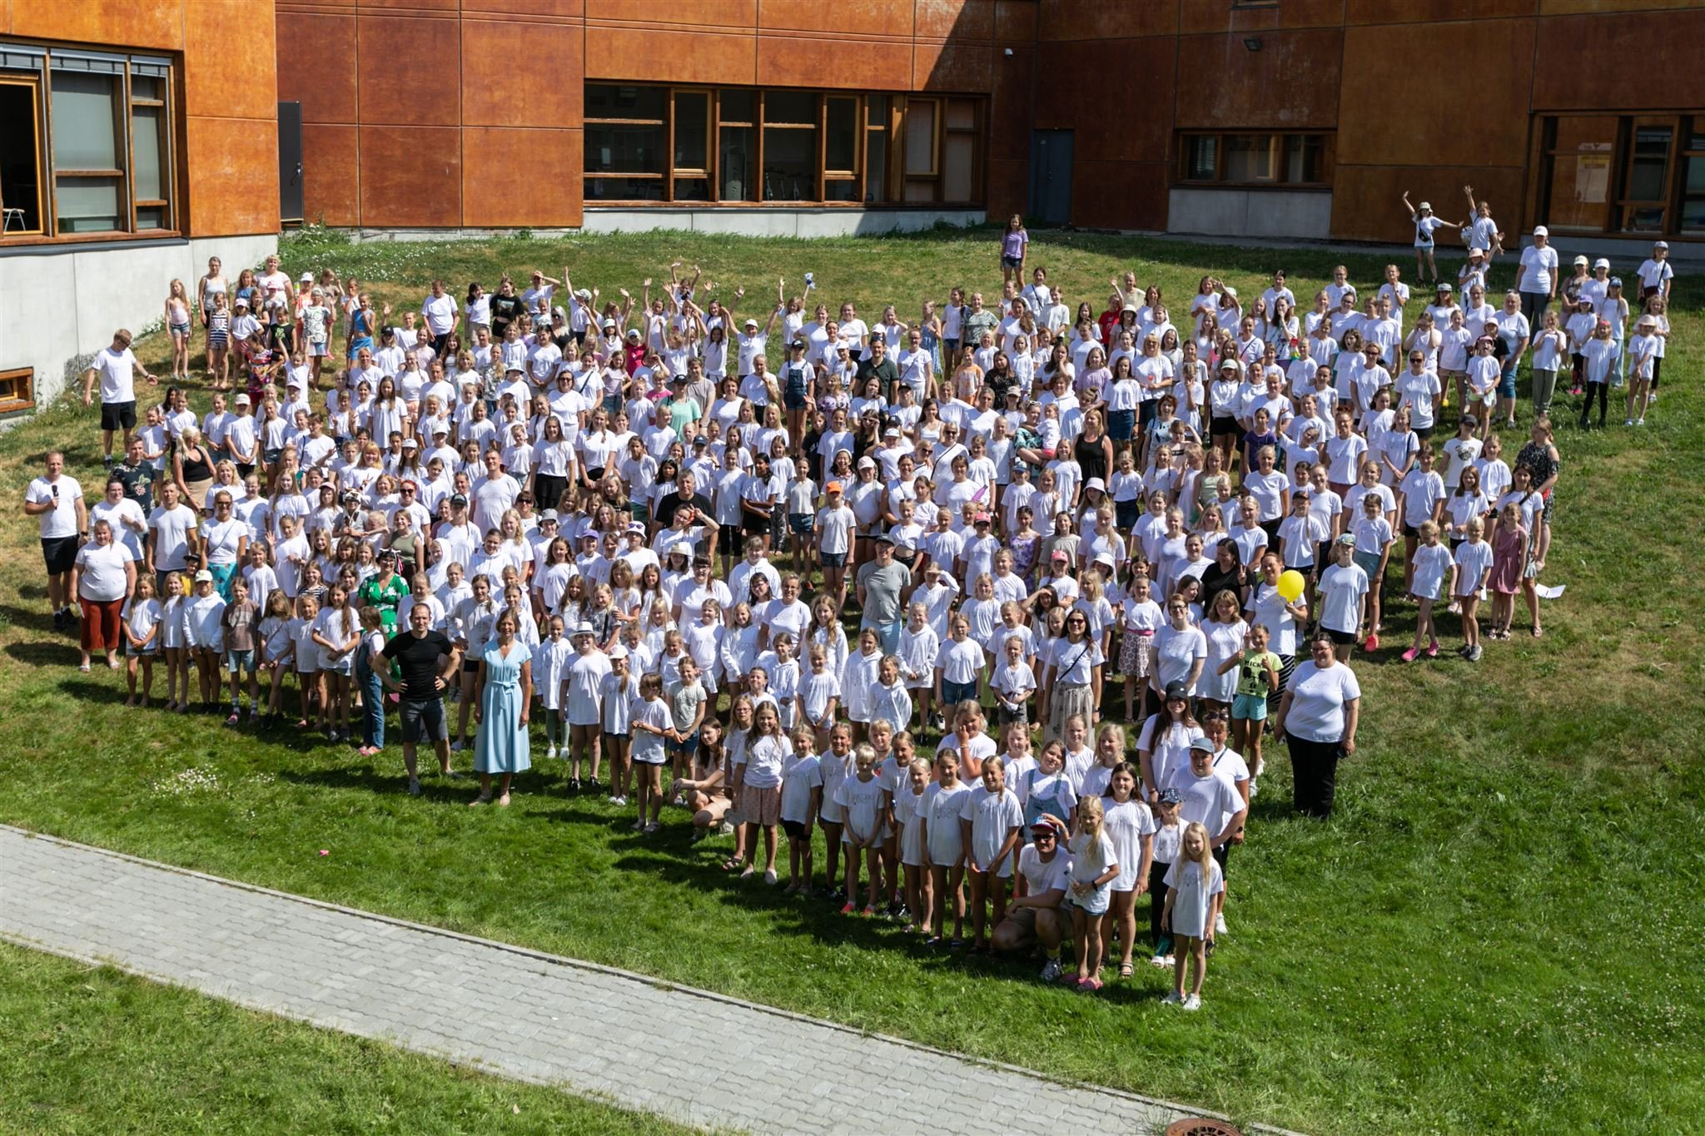
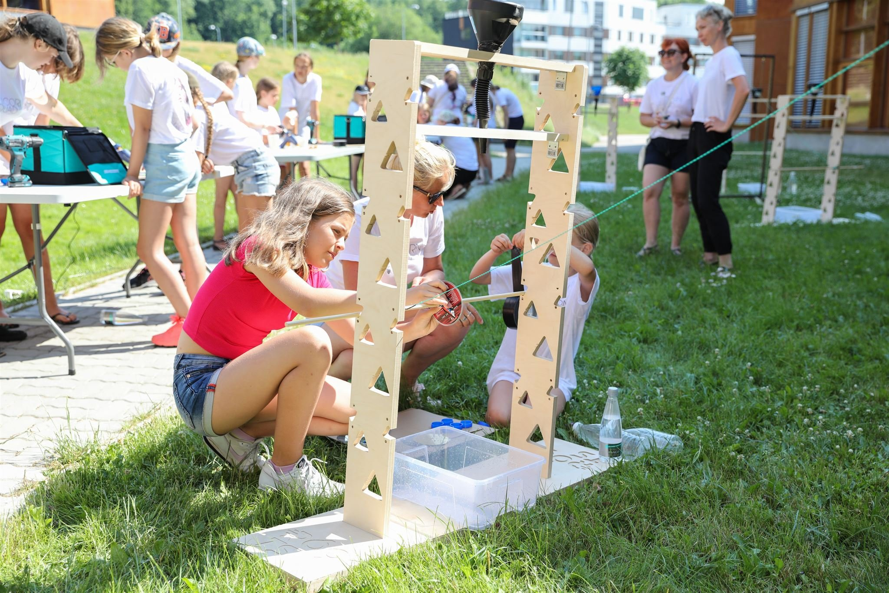
Good examples and practices for teachers, young people and the community to promote gender equality
Only Girls in Tech movement - HK Unicorn Squad
Mission: To increase girls’ interest in technology, robotics and science from an early age and thus increase the number of women working in ICT.
160 groups with over 2,000 participants
Age 7-14
https://www.facebook.com/HKUnicornSquad/photos/3209441399269762
https://unicornsquad.ee/who-we-are/?lang=en

Slide 28

The origin of the name HK Unicorn Squad
The reason and inspiration for the name was provided by the daughter of the initiator of the HK Unicorn Squad Taavi Kotka. Helena Kotka, aged 10 at the time, wanted to be a member of a robotics group and in general, she loved technological stuff.
However, under some confusing circumstances, the number of students in her robotics group was reduced one day, and Helena was excluded because “she wasn’t as active as the boys” (meaning: she was a girl). It irritated Helena’s father, who started looking for like-minded people in order to find a better solution together.
Thus, “HK” stands for the initials of Helena Kotka, and “Unicorn Squad” was added as Helena was wearing a dress with a unicorn’s picture at the time of choosing the name, and it simply felt very inspiring. In addition, unicorns are very special creatures, just like all the girls in our tech squads.
https://unicornsquad.ee/who-we-are/?lang=en

Slide 29
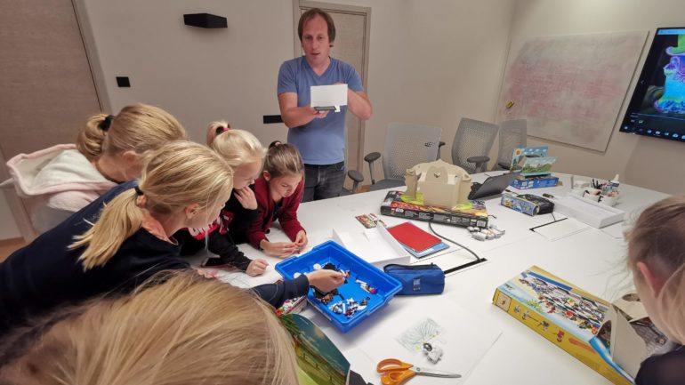

Who is involved
Pupils
Teachers
Parents
Businesses
Local authorities
HK Unicorn Squad’s technology classes are conducted by enthusiastic parents and teachers from all over Estonia.
https://unicornsquad.ee/who-we-are/?lang=en

Slide 30
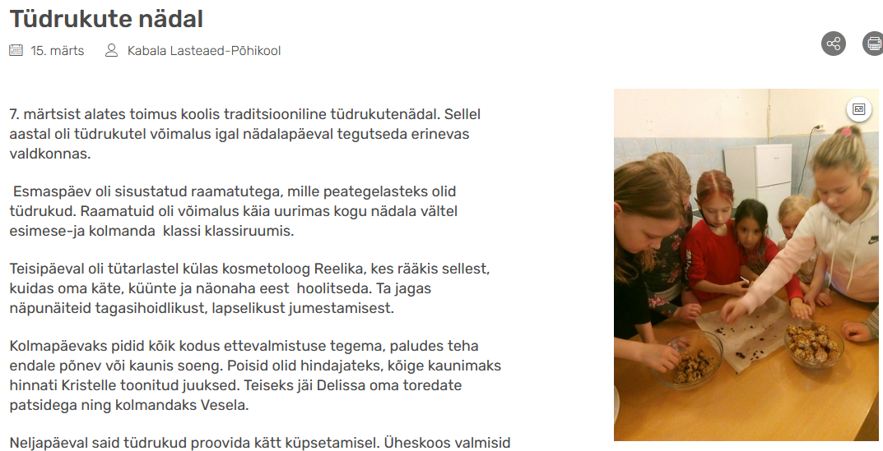

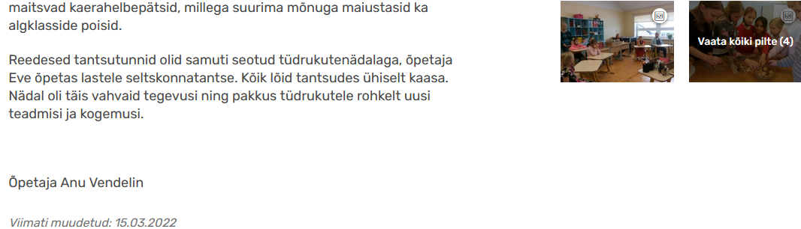
Time to break gender stereotypes in schools involving teachers and students
Girls’ week
Monday – Books
Tuesday - Beautician
Wednesday – Hairstyling
Thursday – Cooking
Friday – Ballroom dancing
https://www.kabala.edu.ee/et/uudised/tudrukute-nadal

Slide 31
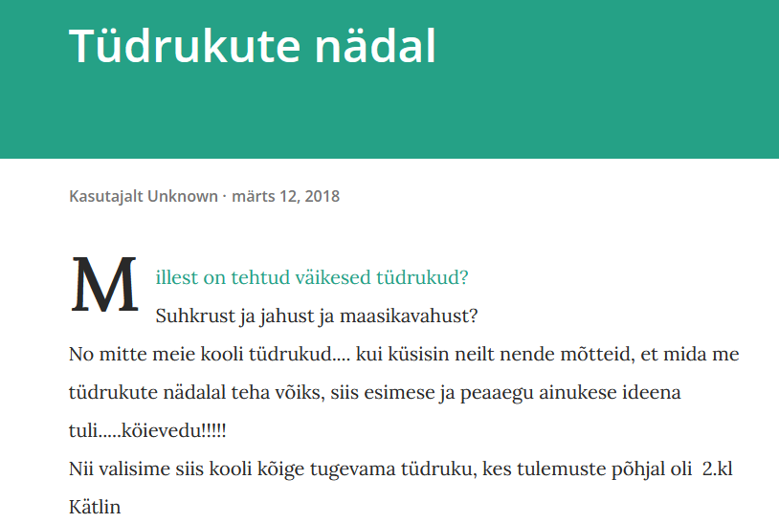
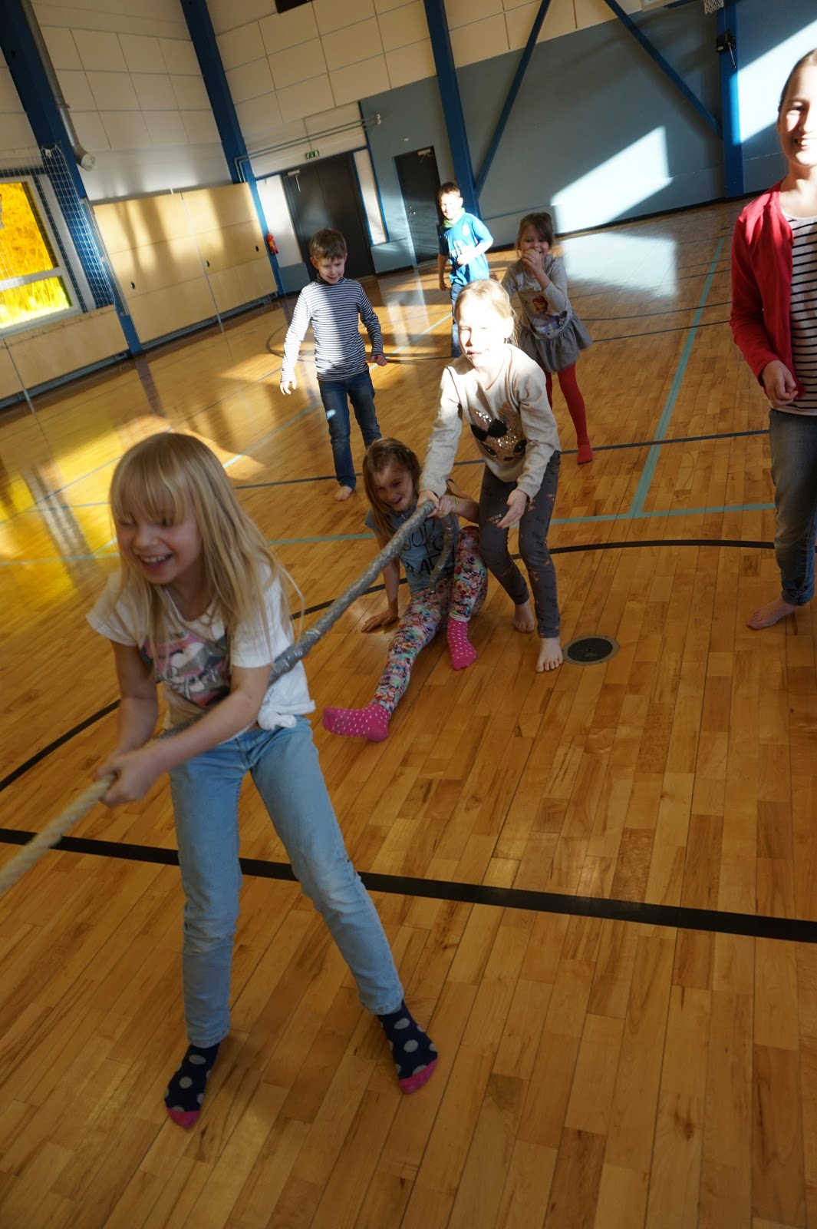
What are little girls made of?
Sugar and spice,
And all that's nice;
That's what little girls are made of.
But NOT IN OUR SCHOOL – The strongest girls in school
tug-of-war
Melliste kool
https://melliste.blogspot.com/2018/03/tudrukute-nadal.html

Slide 32
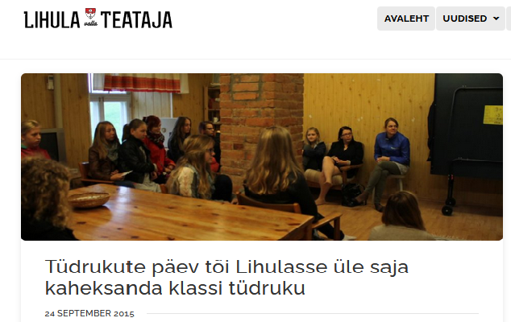
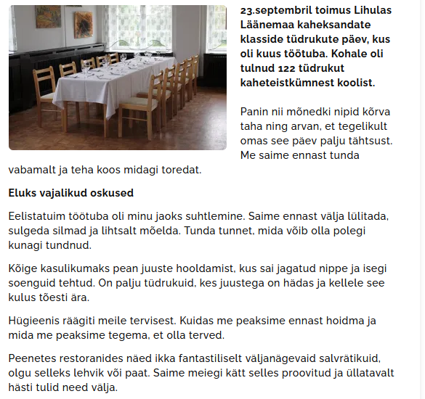
Variõppekava – Õpilasüritused
https://lihulateataja.ee/haridus/tudrukute-paev-toi-lihulasse-ule-saja-kaheksanda-klassi-tudruku/

Slide 33
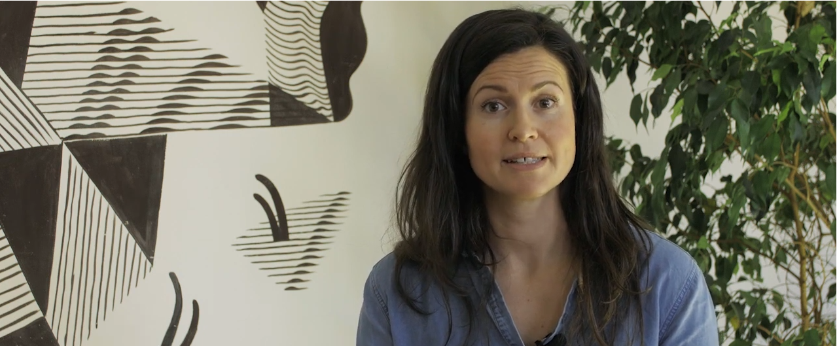
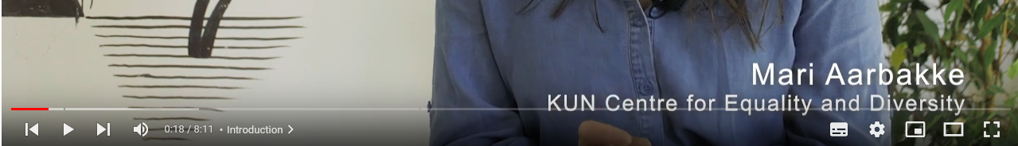
Norm criticism
https://www.youtube.com/watch?v=WVDEPXU2PgA&list=PLyus1Ap7LXnrqUwwc8FC7WGqI4NORvw0_&index=9&t=241s
6.50

Slide 34
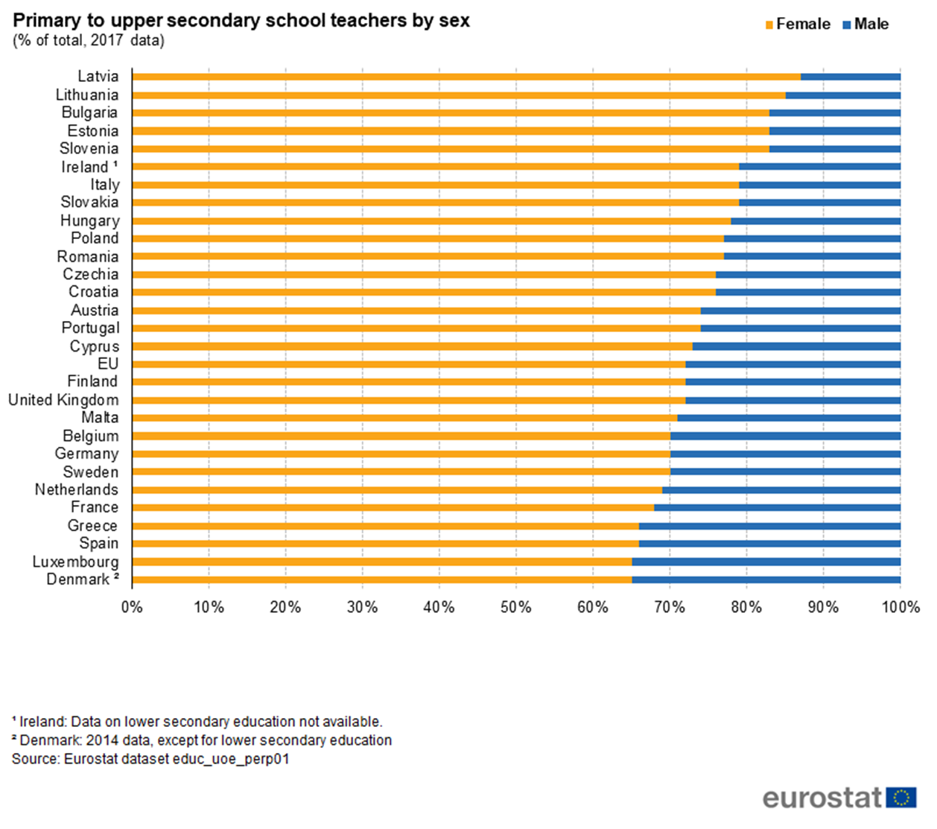
Teaching profession – highly feminized in Estonia

Slide 35
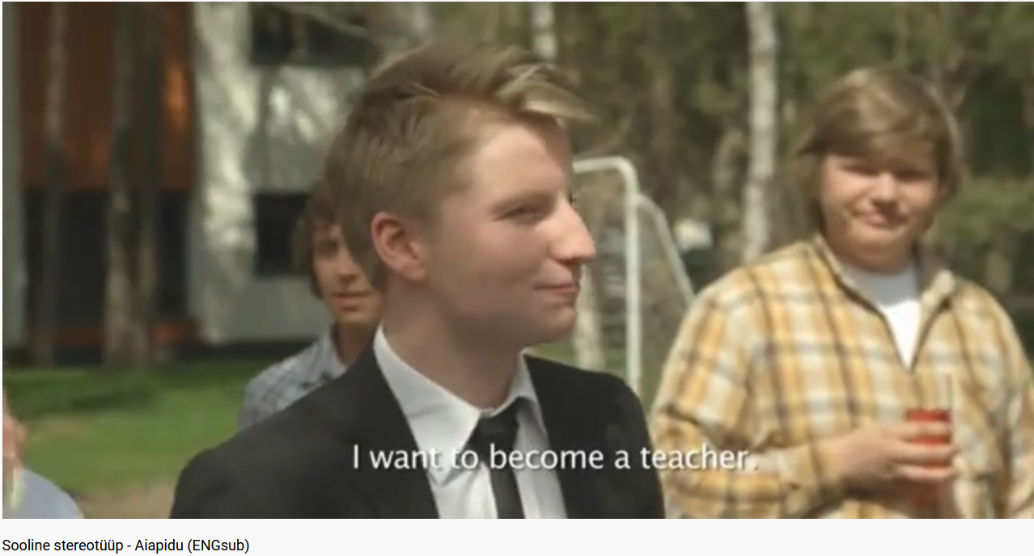
Do you see the stereotype?
Raising awareness of gender stereotypes and their negative impacts
https://www.youtube.com/watch?v=9je8_HEw_8Y
www.stereotyyp.ee

Slide 36
Discussion points
What did the young man want to become?
How did his family and guests react to his career choice?
What jobs did his father offer him?
Whose sons were the young men – the mother’s or the father’s?
Who felt guilty?
What reactions did the young man's choices trigger?
teacher – teacher of Estonian - primary school teacher - nurse
Who supported the young man in his choices?
Will the young man become a teacher?
9. If not, why?
10. What could be done to support boys and girls to choose freely their future
profession without being limited by gender stereotypes

Slide 37
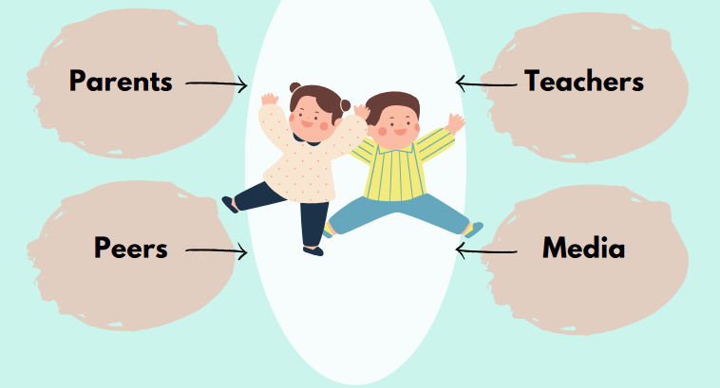
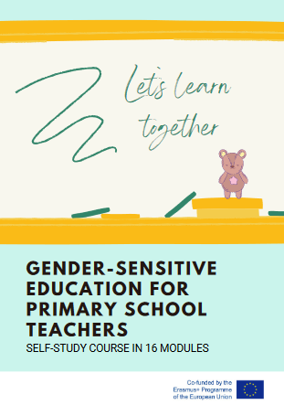
Agents of gender socialization – school and teachers have a critical role to play
https://www.haridusjasugu.ee/wp-content/uploads/Gender-Sensitive-Education-For-Primary-School-Teachers.pdf

Slide 38
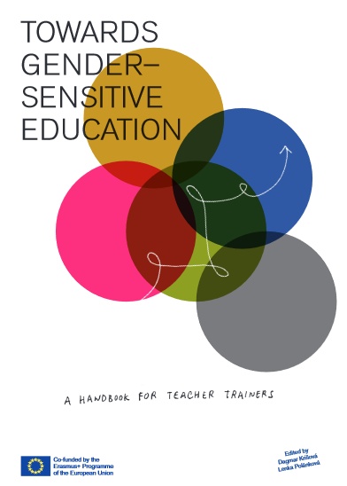
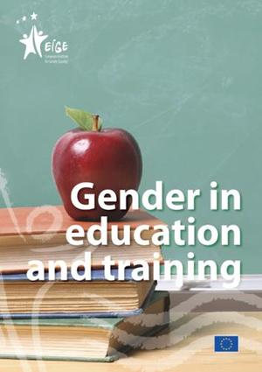
I wish you success with working for a more gender equal future
https://gendersensed.eu/wp-content/uploads/2020/08/A-Handbook-for-Teacher-Trainers.pdf
https://eige.europa.eu/publications/gender-education-and-training

