Slide 1
Norm Criticism
in practice

Slide 2
Find 3-5 wrongs/differences
Criticise the norms

Slide 4
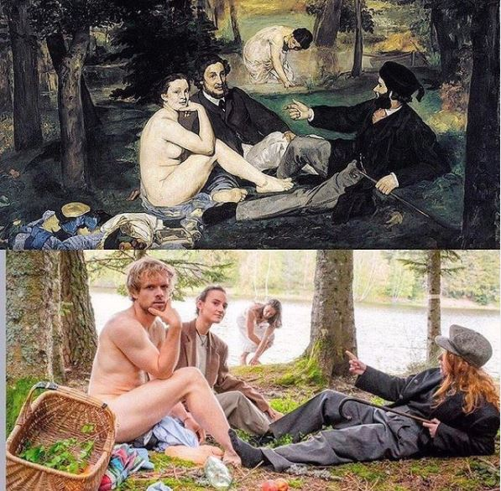

Slide 7
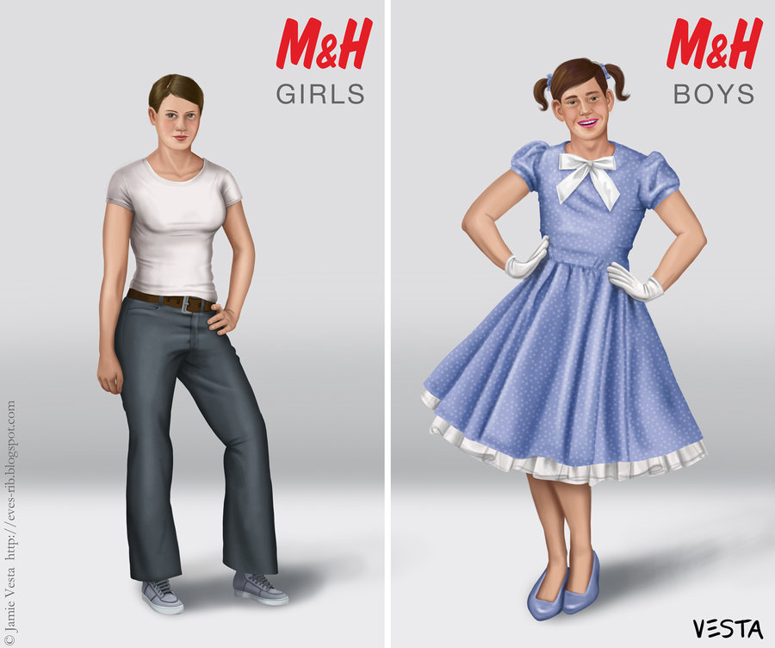

Slide 8
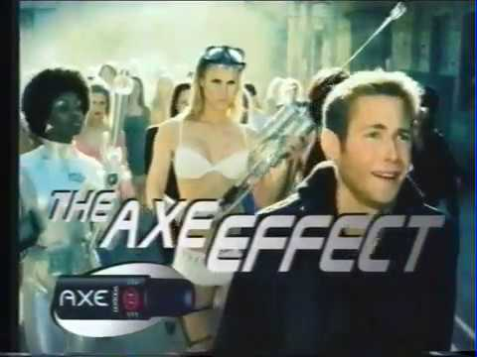
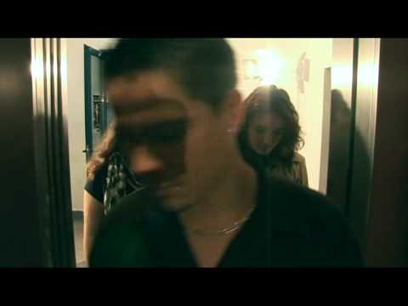
Axe commercial Norm Criticism

