Slide 1
gender approach and norm criticism

Slide 2
Gender theory roots: j. derrida

Slide 3
Michael Focault – judith Butler

Slide 4
Norm criticism

Slide 5
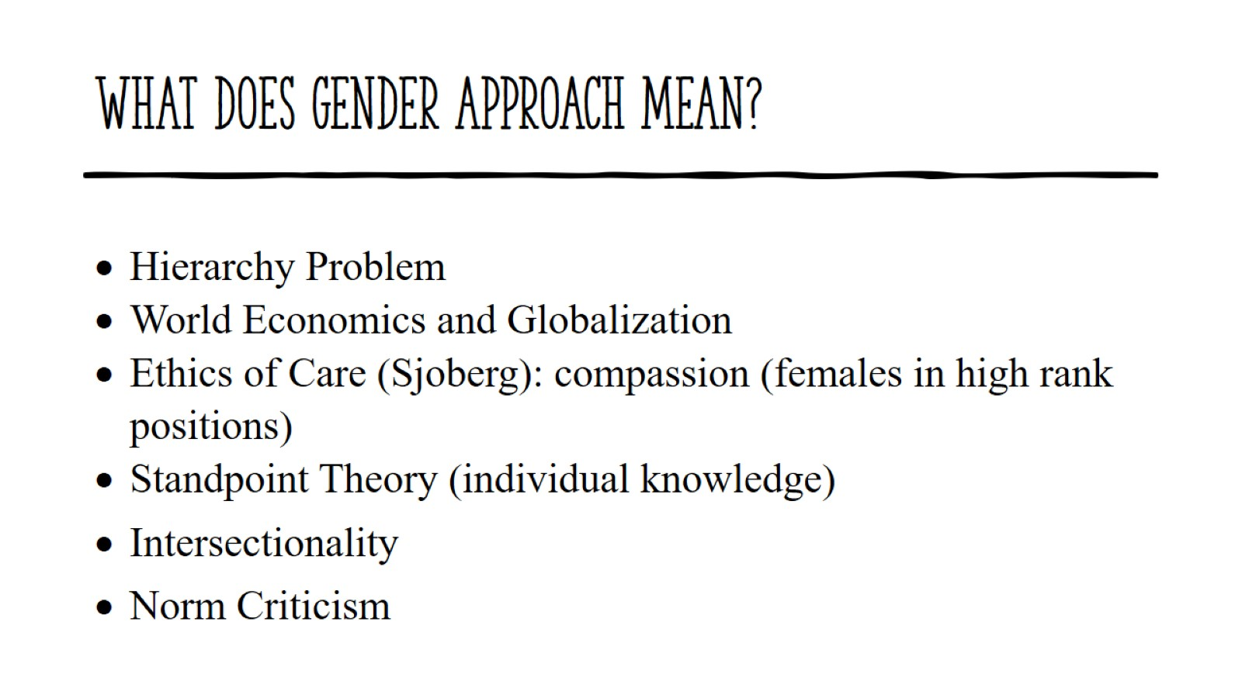
What does gender approach mean?

Slide 6
Intersectionality

Slide 7
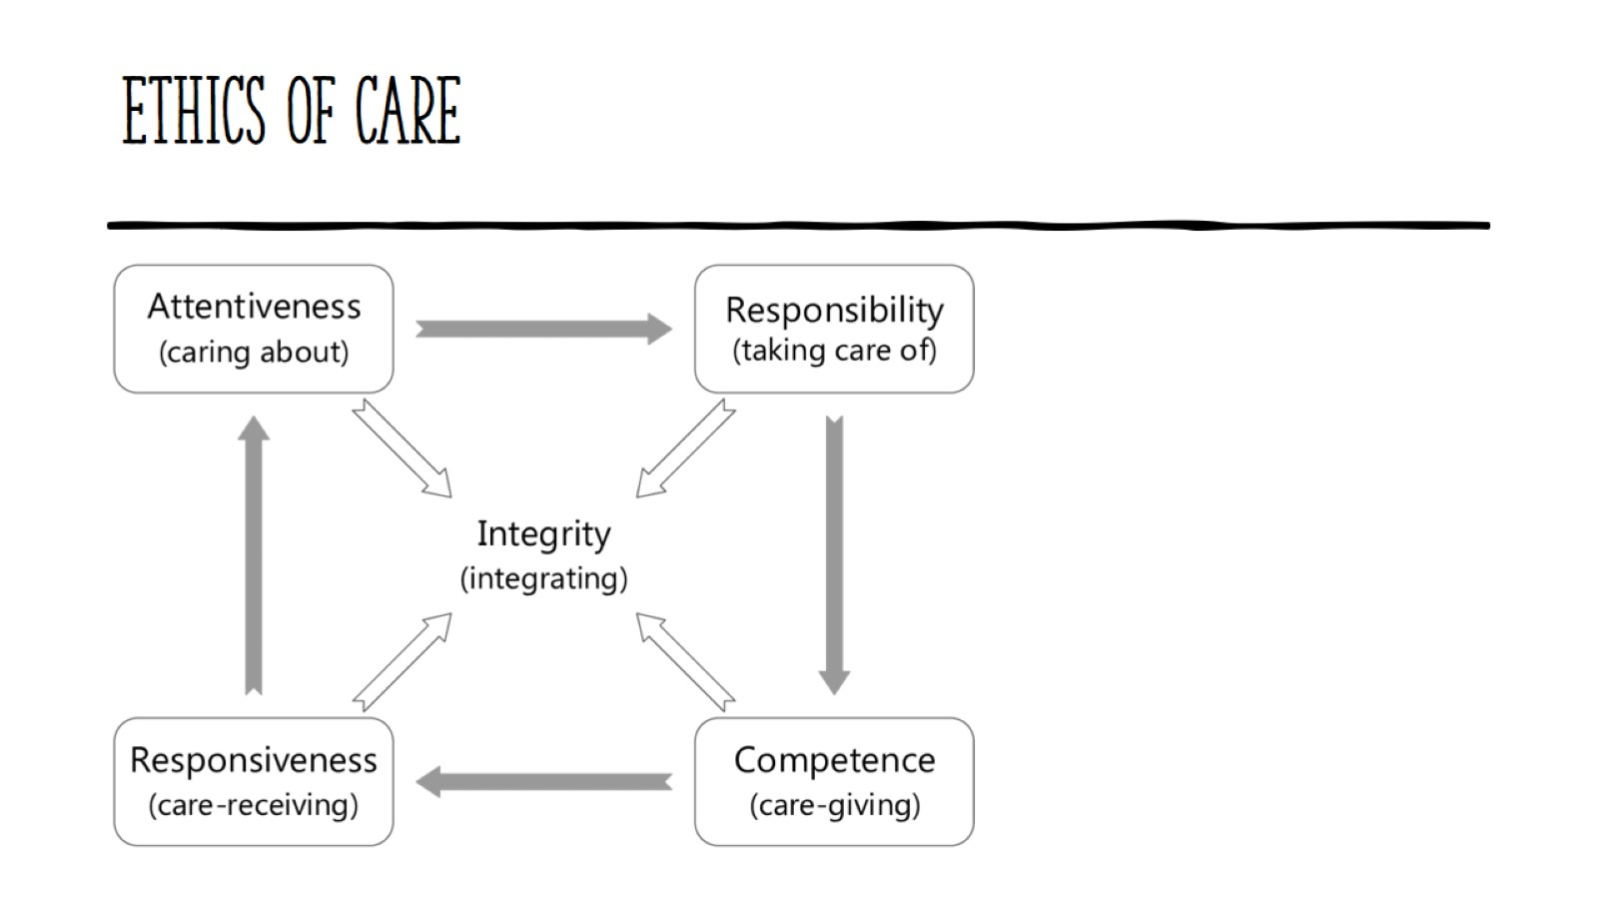
Ethics of care

Slide 8
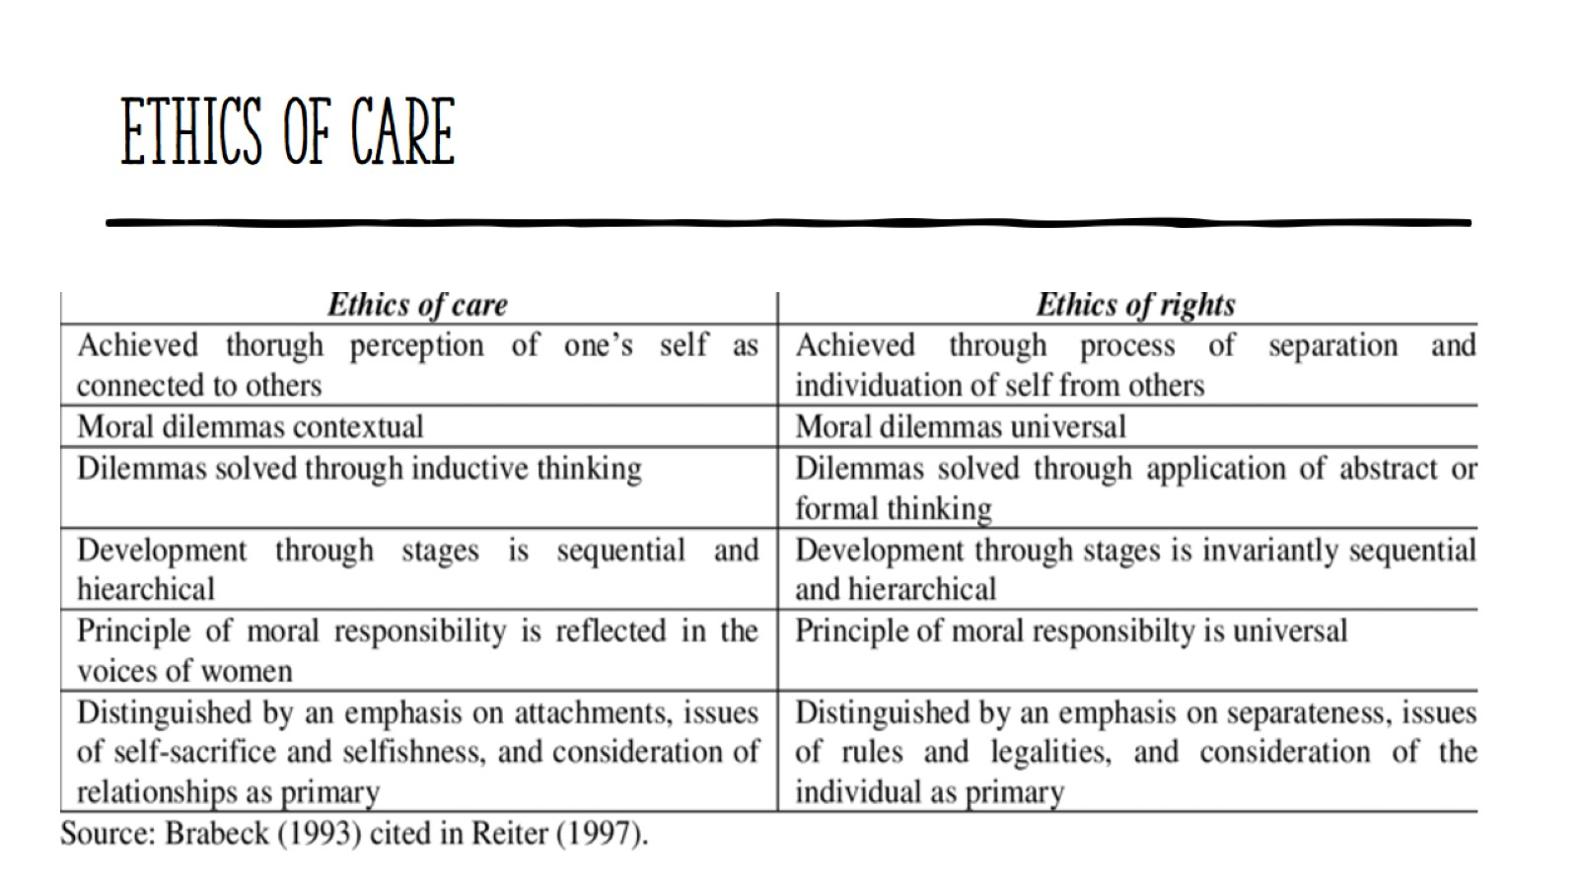
Ethics of care

Slide 9
Questions

